Slide 1
Gender Statistics Analysis
By Cordell Sagan-Lawson,
Desmond Darko, Jeff Ibarra and
Eryk Dobson

Slide 2

ABSTRACT
To find the variance in impact around the globe of education, employment and financial independence on special programs aimed towards women.

Slide 3
Question 1
MAPREDUCE

Slide 4
Question 1: Problem
Identify the countries where percentage of female graduates is less than 30%.

Slide 5
Question 1: Solution
Using MapReduce, find the most recent years for non-null values for gross graduation ratio for females in tertiary education up to five years combined.
Take these percentages and find the average by dividing the sum of the percentages by the number of percentages (years accounted for) isolating below 30%.

Slide 6
Question 1: Conclusions 1
Out of 89 nations, the vast majority in the final output are Third World. Sub-Saharan Africa are on average on the lower end of the percentage range while Asian and some South American countries are closer to the cap of 30%.

Slide 7
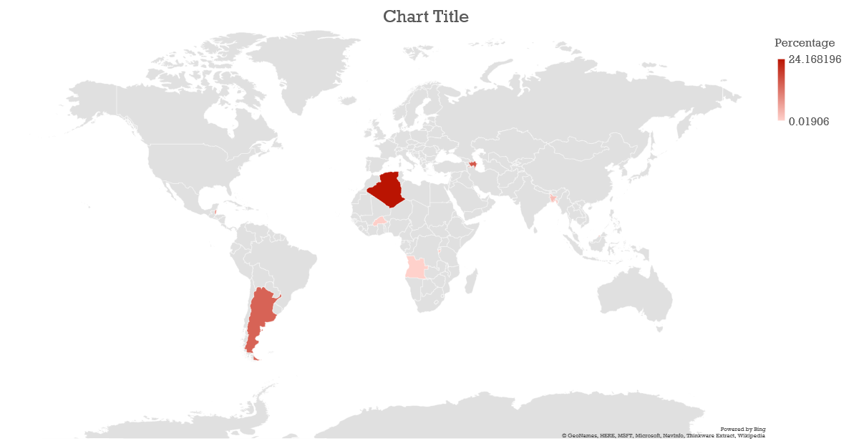

Slide 8
Question 3
MAPREDUCE

Slide 9
Question 3: Problem
List the percentage of change made in male employment from the year 2000.

Slide 10
Question 3: Solution
Using MapReduce, find the percent of employment for the year 2000 and compare it to 2016 or the most recent year. Take both of these percentages.

Slide 11
Question 3: Conclusions
Mostly European countries fell into the negative values for change in male employment since the year 2000 while South American countries’ numbers are rising.

Slide 12
Question 2
HIVE

Slide 13
Question 2: Problem
List the average increase in female education in the U.S. from the year 2000.

Slide 14
Question 2: Solution
Find the percent change between the years 2004 and 2015 (2000 – 2003, 2016 null) for women in the US based on master’s, bachelor’s , secondary school and no schooling and average them.

Slide 15
Question 2: Conclusions
Female education in the US dropped overall by 22% between the years 2004 and 2015.

Slide 16
Question 2: Stipulations
Starting from 2004, all levels of tertiary education were included; however 2012 onward, no other notes in the data included.

Slide 17
Question 4
HIVE

Slide 18
Question 4: Problem
List the percentage of change in female employment from the year 2000.

Slide 19
Question 4: Solution
Find the percent change in the employment to population ratio for females globally between the years of 2000 and 2016, since these were the most recent years after 1999 available for the “WLD” data set.

Slide 20
Question 4: Conclusions
The percentage of change for the world’s female employment went down about 4%.

Slide 21
Question 5
OOZIE

Slide 22
Question 5: Problem
List the percentage of women who are financially independent in all countries.

Slide 23
Question 5: Solution
Using Oozie, find the percentage of self-employed women in all countries.
Countries with null values in this category were converted to zeros for aggregating purposes.

Slide 24
Question 5: Stipulations
The data acquired was limited as only eleven entries had values. The null entries were converted to zeros for aggregating purposes.

Slide 25
Question 5: Conclusions
All of the countries listed in our results are all First World nations.
The nation with the highest percentage was Portugal with a 22% rate of self-employment out of all female employment.

Slide 26
Questions? Comments? Concerns?

